Slide 1
Soybeans Grow in Rows
An introduction to soybeans...

Slide 2
Where did this photo come from?
Is there a soybean field close to your school?
Add it here!

Slide 3
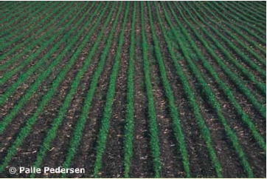
What are soybeans?
Soybeans are a row crop (a crop grown in rows)
They are the world’s leading provider of protein and oil.

Slide 4
Soybeans facts
Soybeans make up 27% of U.S. crop acreage, 2nd only to corn
Ohio planted 4.5 million acres and produced 222 million bushels of soybeans in 2009
How many bushels per acre does that equal?

Slide 5
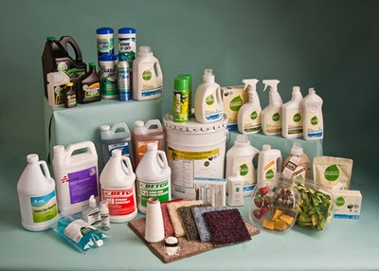
Why do we care about soybeans?
They are used in a variety of food products (vegetable oil, lecithin, tofu, soy sauce, etc.) and for consumer products (paints and inks), fuel, industry (polymers, lubricants), and other applications.

Slide 6
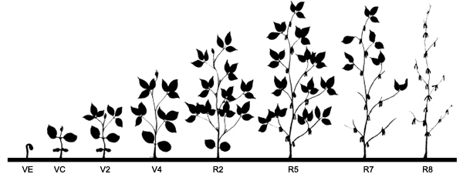
How are they grown?
Soybeans are usually planted in May
They have several stages of growth
  Vegetative Stages (V-Stages)
    VE,VC,V1,V2,V3, Vn
  Reproductive Stages (R-Stages)
    R1,R2,R3,...R8
    Starts at flowering

Slide 7
What helps soybeans grow?
Proper drainage of water
Sunlight
Few to no weeds
Nutrients-the bacteria help to provide nitrogen, but they need phosphorus, potassium and a variety of other nutrients

Slide 8
How many seeds are planted per acre?
Seeding rates are varied, depending on how the rows are spaced
  -generally 125,000-150,000 seeds / acre
Rows can be wide (30 inches apart) or narrow (less than 28 inches apart)
Narrow row spacing has been shown to increase yield, but also increase the need for herbicide

Slide 9
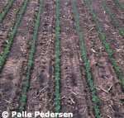
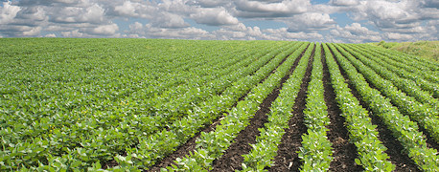
Seeding spacing
15” row spacing
(early)
30” row spacing (mid-season)

Slide 10
What do growers do to encourage growth?
Use fertilizers and pesticides
Buy seed varieties that are resistant to SCN and phytothera or even ones that are resistant to the pesticides growers use (Round-Up Ready)
Buy seed treatments that encourage the growth of bacteria (Rhizobia)

Slide 11
What keeps soybeans from growing?
Soybean cyst nematodes - parasitic roundworms that can infect the roots of soybeans, stunting their growth
Phytothera (root rot) - fungus that is encouraged by improper drainage.
Excessive weed growth within or between the rows can take valuable nutrients from the soil

