Slide 1

Soy Lecithin
When foods contain small amounts of soy on the ingredient label but not a lot of protein, ask yourself:
Would this product benefit from some lecithin?
grownextgen.org

Slide 2
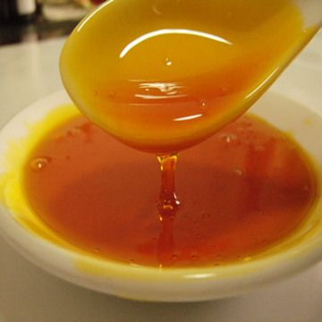
What is it?
Lecithin is a kind of lipid found in many kinds of cells
Within the cells,
lecithin serves a
variety of functions
Notes:
Photo URL: http://www.nguyenlieulammypham.com/upload/images/soy-lecithin.jpg

Slide 3
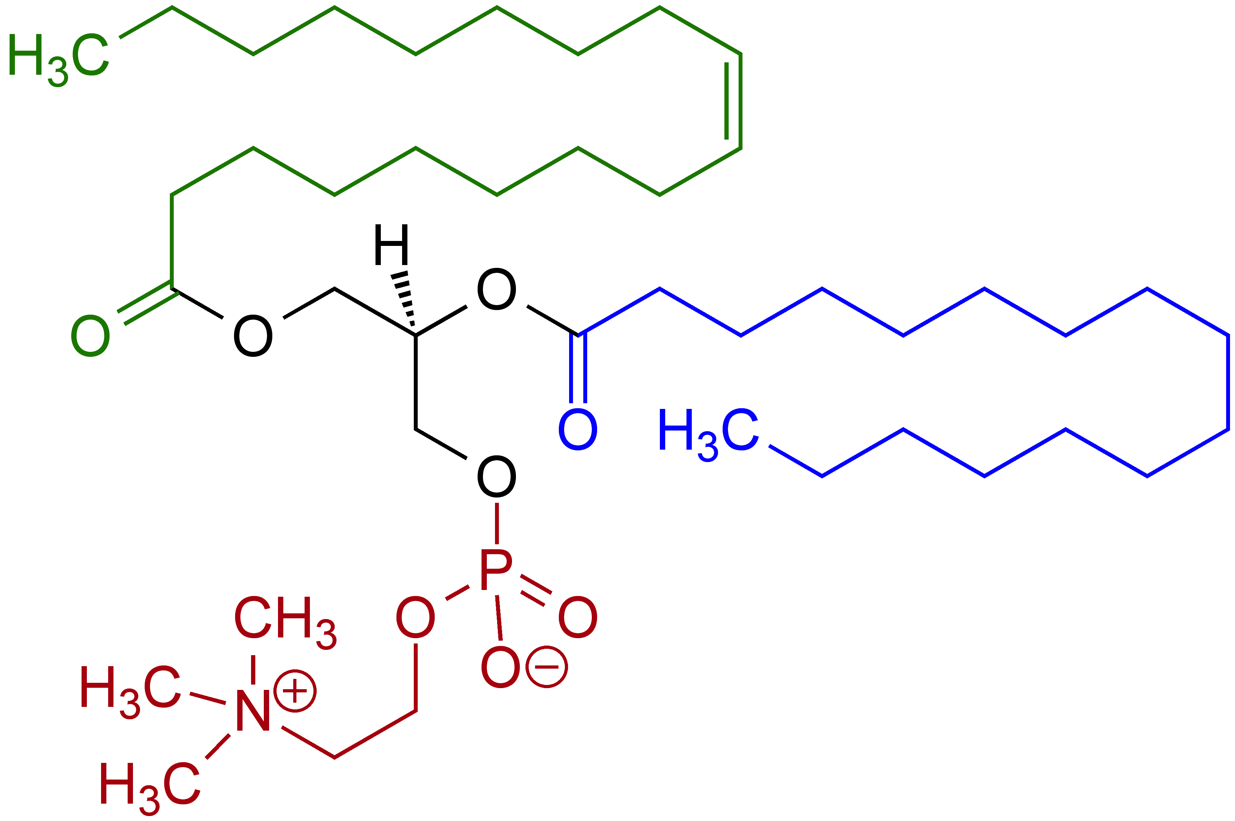
What it looks like
Notes:
What it looks like
Point out the hydrophobic and hydrophilic regions of the compound
Photo URL: http://www.nguyenlieulammypham.com/upload/images/soy-lecithin.jpg

Slide 4
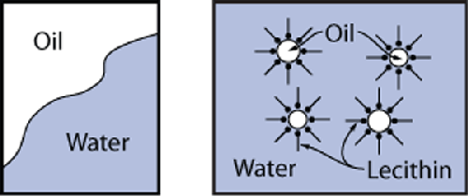
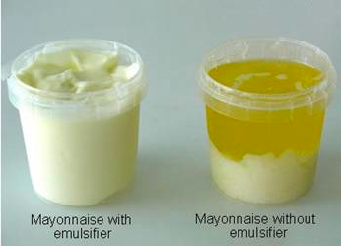
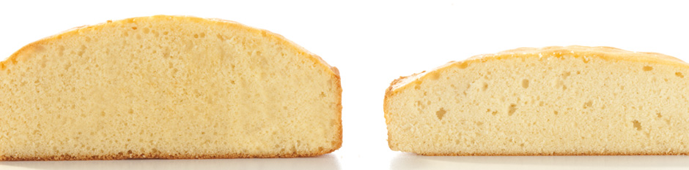
What it does
Lecithin
Without
Notes:
What it does
Because it has hydrophobic and hydrophilic regions, lecithin is able to act as an emulsifier
Image URLS: http://mom.girlstalkinsmack.com/image/062012/Modern%20Industrial%20Chemicals_24.jpg
http://aak-uk.com/products/functional-ingredients/emulsifiers/cake
https://bbsr2chemistry.files.wordpress.com/2013/01/mayo.jpg

Slide 5
Ingredient Functionality
Improves workability
  Decreases dough stickiness and makes it easier to remove from equipment and utensils
Reduces staling
Improves freeze-thaw stability
Improves texture and tenderness
Prevents separation of immiscible liquids
Notes:
What functionality does it provide in food

