Slide 1
Soy Fresh..Soy Clean
Cleaning vs Sanitizing

Slide 2
What is Microbiology?
Study of microorganisms/microbes - minute single cell life forms invisible to the naked eye
  free living
  ubiquitous
  dominant
  diverse
  unicellular/multicellular
Notes:
Free living: capable of independent existence. Don’t form tissue but have all functions of human body
Ubiquitous: everywhere. Normal flora (E.coli in colon)
Dominant Orgs: in terms of numbers and range of distribution
Diverse: In form and function

Slide 3
So Why Micro…
Microbial relationship w/ humans
  mutualistic yet opportunistic 😐
Microbial relationships to life processes
Beneficial aspects played by microbes
Microbes and research
Notes:
1. W/ regards to their role as normal flora and being causative agents of non-infectious and infectious diseases
- Have students name some important microbes (strep, staph, e coli)
2. W/ respect to infections, diseases, emerging and reemerging microbes.
- less than 1% cause disease
3. More beneficial than detrimental to human life and environment
4. Used as model organisms (studying of life processes),
- microbes have short generation time
- simple structure
- large numbers (offspring)

Slide 4
Micro & Biotech…
Food & beverage production
Pharmaceutical productions
Agriculture
Environment
Sewage Treatment
Notes:
Why would each of these be important in relation to biotechnology?
1. Preservation, fermentation
2. Medications/drugs (antibodies)
3. Insecticides
4. Decomposition, Biogeochemical cycling, Composting
5. Bioremediation: clean up of wastes/pollutants

Slide 5
World of Testing Food
Microbes play an integral role in food safety & quality
  Several regulatory agencies, scientific groups, & industries provide standardized testing to ensure the safety & quality of food production
    FAD (Food Adulteration & its Detection) - 1st text
    FDA (Food & Drug Administration)
    USDA (US Dept of Agriculture)
    BAM (Bacterial Analytical Manual)

Slide 6
Food Microbiology
Bacteria, molds, & yeast
  Factors affecting the growth of microbes in foods
    pH
    temperature
    O₂
    biological structures
  Factors causing microbial presence in foods
    Personal hygiene
    Food processing & preparation
    Holding temps
Notes:
1. Most commonly found and important to food quality and safety
2. Have the students describe food micro,
3. Other factors of growth, and
http://books.google.com/books?id=1HzwMTjzFigC&pg=PT625&lpg=PT625&dq=U.S.+Food+and+Drug+Administration's+Bacteriological+Analytical+Manual&source=bl&ots=8VtNmzAMFD&sig=dBobu7iRtxliea3pZeRqw43OlMs&hl=en&sa=X&oi=book_result&resnum=4&ct=result#PPT620,M1
4. How food may be contaminated
http://books.google.com/books?id=1HzwMTjzFigC&pg=PT625&lpg=PT625&dq=U.S.+Food+and+Drug+Administration's+Bacteriological+Analytical+Manual&source=bl&ots=8VtNmzAMFD&sig=dBobu7iRtxliea3pZeRqw43OlMs&hl=en&sa=X&oi=book_result&resnum=4&ct=result#PPT778,M1

Slide 7

Silliker Food Lab
Dr. John H. Silliker, Ph.D. in 1967
Independent food lab
  Leading internationally accredited food testing and consulting network
  Quality assurance, safety, & nutrition
  Accurate and consistent results on time
  Quantitative & qualitative testing
    Qual → food borne pathogens → PCR and ELFA
    Quan → spoilage & indicator org’s → plating, reading, serology
"Give clients more than just reliable analytical results, give them practical solutions to their problems."
Notes:
1. Rapid methodologies: Enzyme Linked Fluorescent Antibodies (ELFA) much like ELISA but automated and polymerase chain reaction (PCR)

Slide 8
Food Protection & Quality
Effective food protection for human life
  safe, attractive, appetizing, nutritious, & free of disease/poisons
4 Absolutes of Quality
  Conformance to customer requirements
  Achieved through prevention
  Zero defects
  Quality improvement MUST be measured
Notes:
Four absolutes:
1. Give them what they want
2. Details, details, details
3. No mistakes. First time is the right way
4. QA114s (investigations)

Slide 9
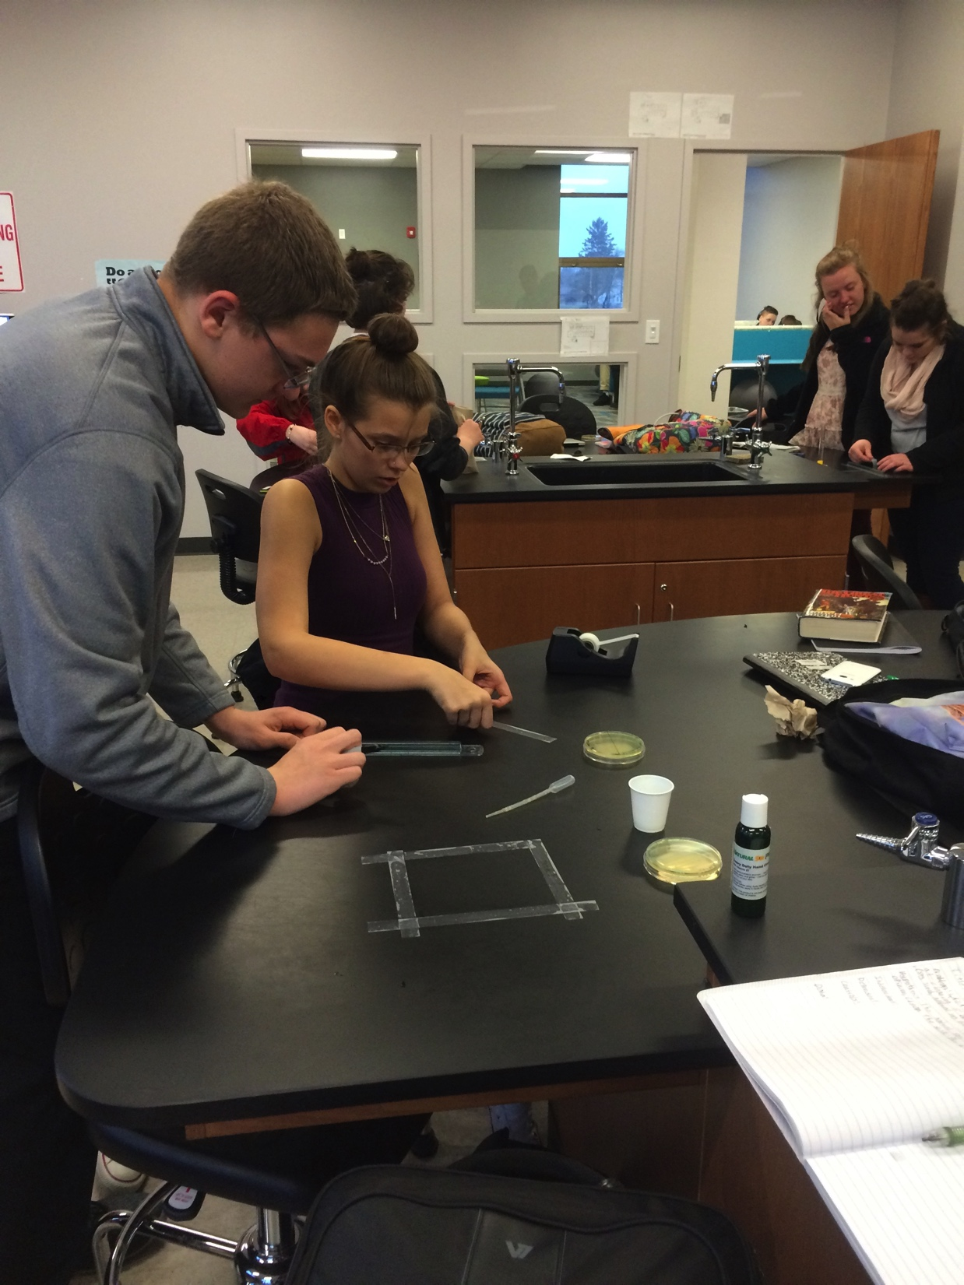
Clean or Sanitize?
Cleaning
  Removing the visible/non-visible products (biofilm) from a work station surface
    Buildup ↔ microbial resistance
Sanitizing
  Kills any residual microbes on the surface
    Allowing to sit for 15min further breaks down biofilm & hinders other microbial growth
Notes:
Students can go online to find the definition of a biofilm
http://books.google.com/books?id=j0ZSJNuxN0IC&dq=biofilm&printsec=frontcover&source=in&hl=en&sa=X&oi=book_result&resnum=12&ct=result#PPA1,M1

