Slide 1
Emulsions

Slide 2
What are Emulsions?
An emulsion is a colloid in which liquids that do not normally mix are spread throughout each other.
Emulsifying is done by slowly adding one ingredient to another while simultaneously mixing. This disperses and suspends tiny droplets of one liquid through another.
http://www.naturphilosophie.co.uk/perfect-hollandaise-sauce-science-kitchen/

Slide 3
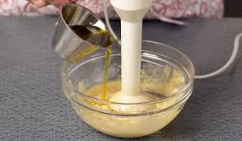
Purpose of emulsifers..
To prevent a mixture from separating.
An emulsifier is attracted to both oil and water, thus allowing the two to mix.
An emulsifier functions by surrounding the oil droplets to form a protective coat which holds the oil droplets in suspension.
One part of the emulsifier molecule (the polar end) is soluble in water and one part is soluble in the oil (the non-polar end).

