Slide 1

Simulation of the Likelihood of Plant Growth
C. Crawford
Dublin City Schools, Dublin, Ohio
&
M. Dunn
Miami University, Oxford, Ohio
Developed Spring - Summer 2013
Notes:
Note to the teacher:
This is an activity for students to look at the factors influencing plant growth.
Possible Introduction to class:
Today we will be doing a simulation of the likelihood of plant growth. We will be using dice to represent natural events.

Slide 2
Leading Questions
In your lab notebook answer the following:
What environmental factors are required for a plant to sprout?
What environmental factors are required for a plant to grow?
What cellular factors are necessary for a plant to grow?
Notes:
Environmental Factors to sprout:
moisture
temperature
it is important for students to know that sunlight is not necessary for a plant to sprout.
Environmental Factors to grow:
sunlight
moisture
carbon dioxide
soil or nutrient source
Cellular Factors:
energy
cell replication

Slide 3
The Simulation for Biology

Slide 4
Roles within the Simulation
Farm Hand
Agronomist
Responsible for rolling the dice
Looking for causes of mortality
Worksheet #1
Farm Manager
Seed Representative
Responsible for rolling the dice
Worksheet #2
Responsible for determining % error
Worksheet #3

Slide 5
Data Collection
Four-sided is the Environmental Dice
Ten-sided is the Cellular Dice
Roll both the four-sided and ten-sided dice and record values in both
  the data table (Worksheet 1) and
  the flow chart (Worksheet 2)

Slide 6
Viability – Environmental Die
  A roll of 1 with this die represents inadequate environmental factors resulting in death of the plant (D)
    1 = DEAD → record a D in data table
  A roll of not 1 with this die represents viable environmental factors resulting in the viability of the plant to grow (V)
    NOT 1 = VIABLE → record a V in data table

Slide 7
Cellular Inhibition Dice
An odd roll of this die represents inhibition (I). The specific inhibitors are represented on Handout 1.
    ODD = INHIBITED → record a I in data table
An even roll of this die represents normal functioning (N)
    EVEN = NORMAL → record a N in data table

Slide 8
What was Inhibited?
Using the reference sheet, look-up what is being inhibited
Record in Data Table (Handout 1)
What was the effect on plant?
Record in Data Table (Handout 1)

Slide 9
Probability of Viability
Information for Handout 3
There are “n” number of trials in which the experiment has taken place
n=40
10 not viable
30 viable
What is the likelihood that the environmental conditions are suitable for plant growth?
  30 out of 40 or 25%

Slide 10
Probability of Viability
  What is the likelihood that inhibition takes place?
    because you are using a ten sided dice. The Ratio will be 15 of 30 or ½
n=40
10 not viable
30 viable
15/30
15/30

Slide 11
Theoretical Values
n=40
Four sided die:
A roll of 1 is death
A non 1 roll is viable
Death
Viable
10 sided die:
Odd is inhibited resulting in death in one of five ways
Even is normal resulting in growth
Inhibition
Growth

Slide 12
What is the success rate?
What is the theoretical probability for the success of the plant?
What is the theoretical probability for death by one of the inhibitions?
What were the actual results?
What is the percent error

Slide 13
Follow up
What is an acceptable percent error?
What happened to the percent error as we added in more values?

Slide 14
Reception and Inhibition

Slide 15
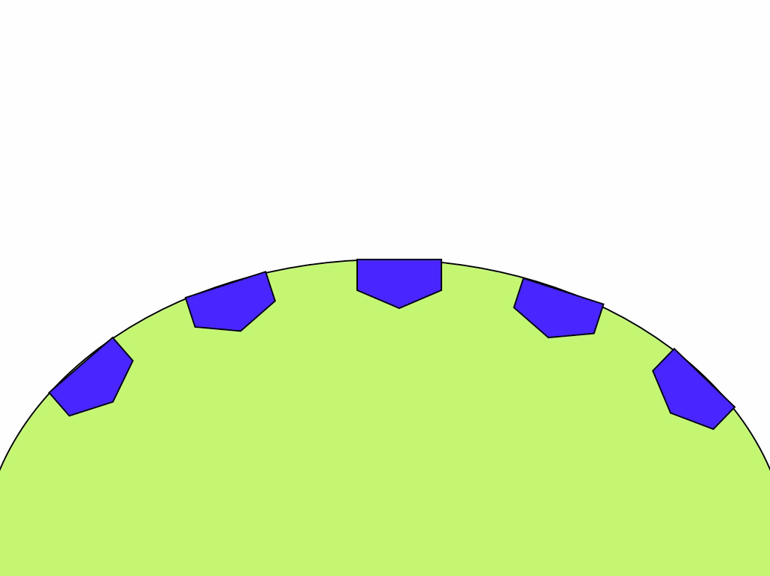
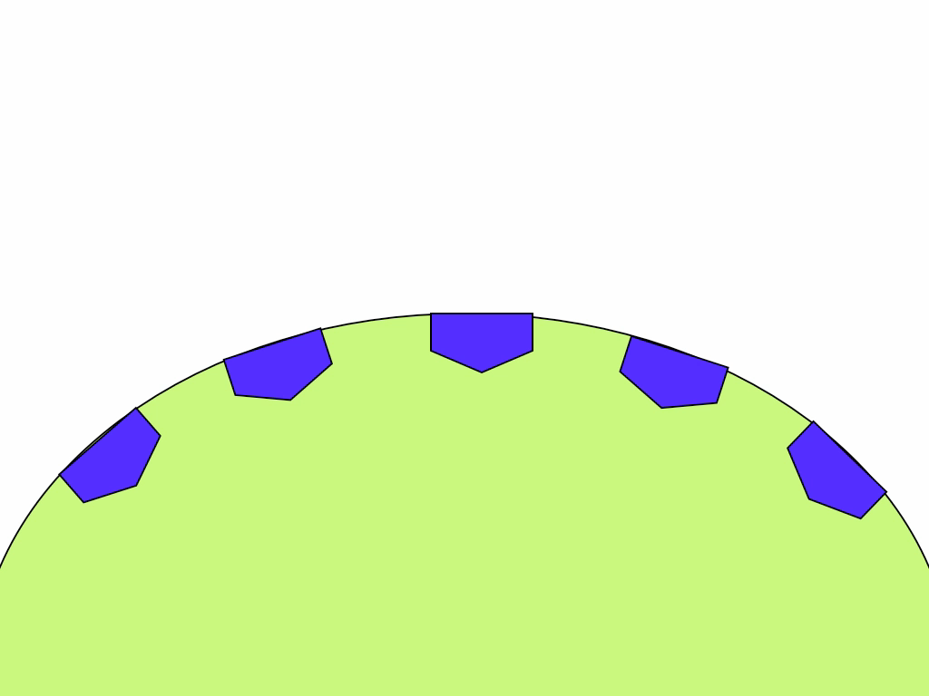
Receptor Site
Definition: The location of a signal molecule bonding (substrate) to the active site of an enzyme
Notes:
Click at the bottom of the screen to play movie.

Slide 16
Receptor Site Specificity
Receptor sites are unique:
specific to a certain molecular shape
trigger only under certain conditions
When shut down, malformed, or inhibited, the reaction pathway cannot complete
Notes:
Receptor sites are often specific to a certain molecular shape (These are simplified shapes in many animations to make it easier to illustrate. In reality they look very different)
Signal sequences and specific chemical interactions make each receptor chain unique to triggering only under certain conditions
When receptor sites are shut down, malformed, or inhibited, the reaction pathway cannot complete

Slide 17
Why would you want to keep something from catalyzing at the receptor site?
Notes:
The hope from this question is to get the students to say that they want to inhibit something from happening. Although they may not use the word, they should be able to come up with the idea.

Slide 18
To inhibit enzyme activity
- or - to stop specific reaction pathways
Notes:
Inhibitors are important because they hinder the normal functioning of enzymes and the correlated reaction pathways
Specific inhibitors can prevent the creation of amino acids and lipids for example, hindering the creation of proteins and the repair of the cellular membrane and other organelles
Note to the teacher:
Depending on point of introduction, reference the importance of lipids and amino acids. They act as building blocks for these more complex structures. Without these basics protein creation and then organelle development would be severely stunted.
More clarification of importance of specific inhibitors on following slides

Slide 19
Important types of Inhibitors
Enzyme Inhibitors:
  Decreases enzymatic activity
  Can prevent substrate binding to enzymatic active sites
Reaction Inhibitors:
  Shuts down specific reaction pathways
  Can prevent catalyst functioning
  Can prevent creation of necessary reactants

Slide 20
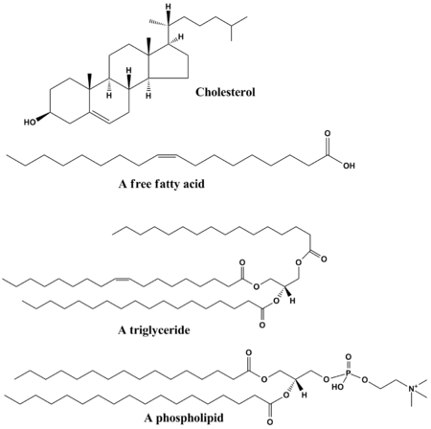
Lipid Synthesis Inhibitor
Lipids are the building blocks of cell membranes and necessary for all organelle production
Lipid synthesis occurs primarily at the root and shoot meristems where growth is primary
Image Source: http://en.wikipedia.org/wiki/File:Common_lipids_lmaps.png

Slide 21
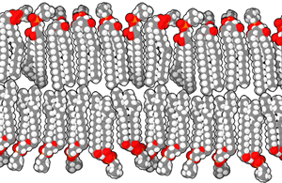

Lipid Synthesis Inhibitor
Lipid synthesis inhibitors prevent the development of new lipids for membrane repair, replenishment, and growth
New lipids are required for new cell division and cell growth
Image Source: http://en.wikipedia.org/wiki/File:Lipid_bilayer_section.gif

Slide 22
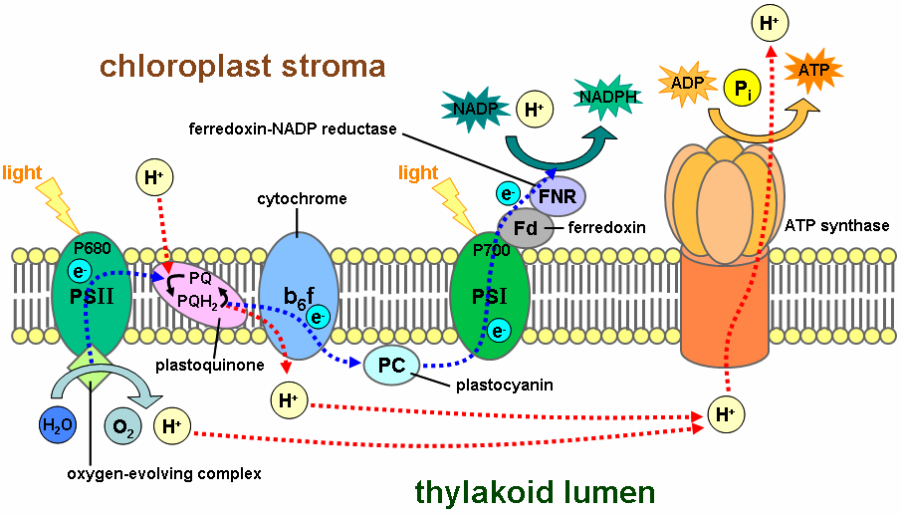
Cell Membrane Disruptors
Cell membranes in plants are dependent on proper functioning of the Electron Transport Chain (ETC) in the photosynthesis process
Cell Membrane Disruptors convert the superoxide (O2-) to H2O2
Image Source: http://en.wikipedia.org/wiki/File:Thylakoid_membrane.png

Slide 23
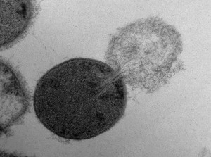
Cell Membrane Disruptors
These molecules can yield hydroxyl (OH-) ions, the most potent of biological oxidants
Cell Membrane Disruptors overload cellular processes and OH- oxidation can lead to cell membrane lysis and the leakage of cellular contents
Image Source: http://www.gtresearchnews.gatech.edu/holes-antibacterials-create/
Transmission electron microscopy image of a Streptococcus pyogenes cell experiencing lysis after exposure to the highly active enzyme PlyC. (Click image for high-resolution version. Credit: Daniel Nelson, UMD)

Slide 24
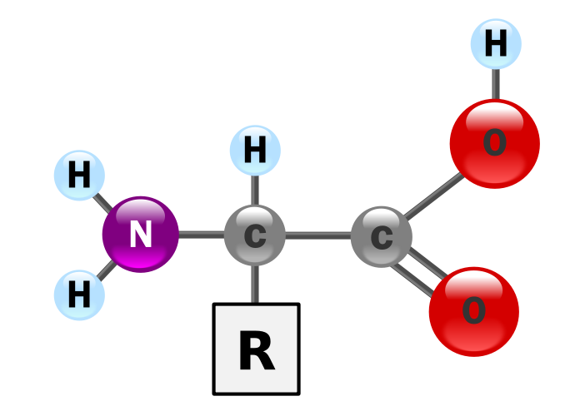
Amino Acid Synthesis Inhibitor
Amino acids are the building blocks of proteins
Humans utilize 20 standard amino acids, 9 of which cannot be produced by the body
New protein production is prevented by the lack of available amino acids
Image Source: http://en.wikipedia.org/wiki/File:AminoAcidball.svg

Slide 25
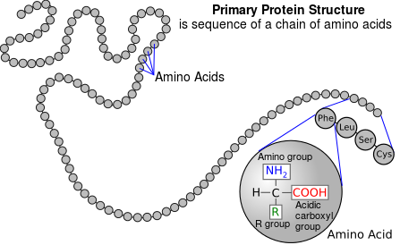
Amino Acid Synthesis Inhibitor
Amino acid synthesis inhibitors prevent the development of new amino acids
The amino acid chain is referred to as the primary structure of a protein
Image Source: http://en.wikipedia.org/wiki/File:Protein_primary_structure.svg

Slide 26
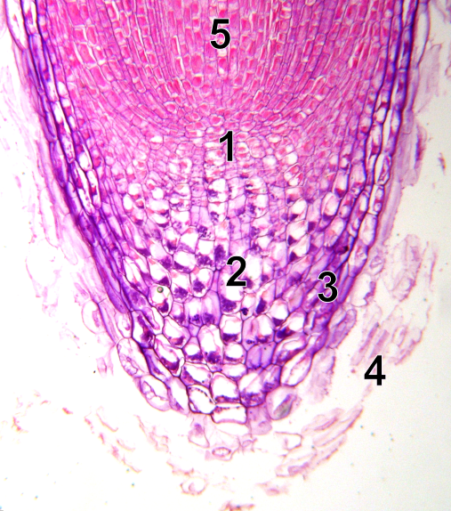
Seedling Growth Root Inhibitors
Seedling growth in the roots is highly dependent on rapid cell division in the root meristem
Root elongation and lateral root formation is prevented by these inhibitors
Image Source: http://en.wikipedia.org/wiki/File:Root-tip-tag.png

Slide 27
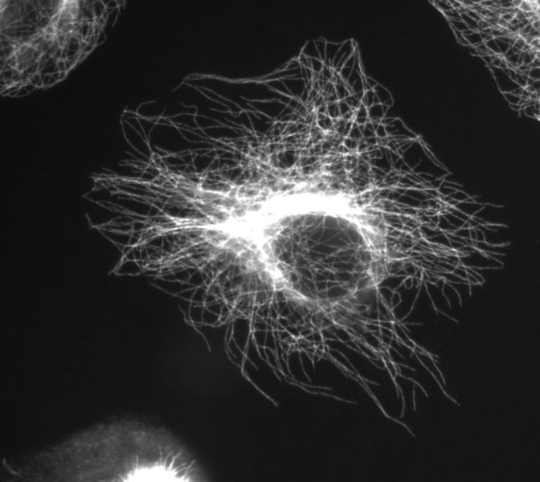
Seedling Growth Root Inhibitors
Seedling Growth Root Inhibitors prevent cellular division in meristem regions
These inhibitors prevent microtubule formation
Image Source: https://en.wikipedia.org/wiki/File:Btub.jpg

Slide 28
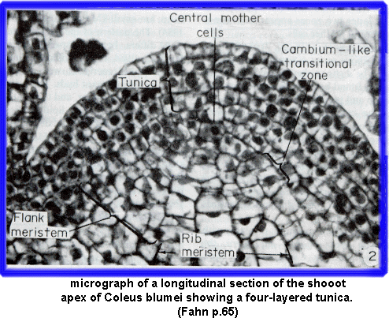
Seedling Growth Shoot Inhibitors
Seedling Shoot Growth is dependent on the rapid cell division in the apical meristem of the growing stem as well as the root
The shoot apical meristem is responsible for stem elongation
Image Source: http://www-plb.ucdavis.edu/labs/rost/rice/stems/meristem.html

Slide 29
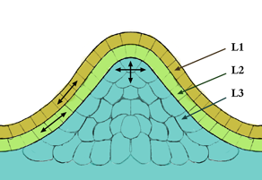
Seedling Growth Shoot Inhibitors
Specific site of action is unknown
Seedling Growth Shoot Inhibitors prevent the elongation and further growth of the seedling shoot
Image Source: http://en.wikipedia.org/wiki/File:Méristème_couches.png
Notes:
Possible Discussion Point:
What are the possible action sites based on seedling growth root inhibitors?

Slide 30
Follow up
What keeps a plant from growing?
Is there anything we can do to make plants grow better?
Why is molecular structure so important in biology?

Slide 31
Simulation of the Likelihood of Plant Growth
C. Crawford
Dublin City Schools, Dublin, Ohio
&
M. Dunn
Miami University, Oxford, Ohio

