Slide 1

Calculating Molarity and power of the hydronium ion
A brief introduction to solutions and pH calculations
grownextgen.org

Slide 2
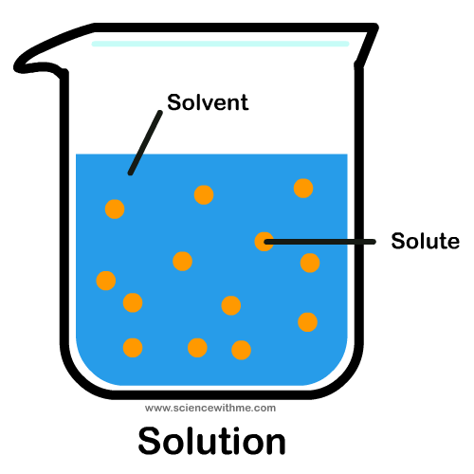
What is a solution?
Mixture
Two basic components
  Solute: dissolved substance
  Solvent: dissolving substance
  e.g. salt in water, air in cream,
    fats in milk, acids in water
    http://sciencewithme.com/learn-about-solutions/

Slide 3
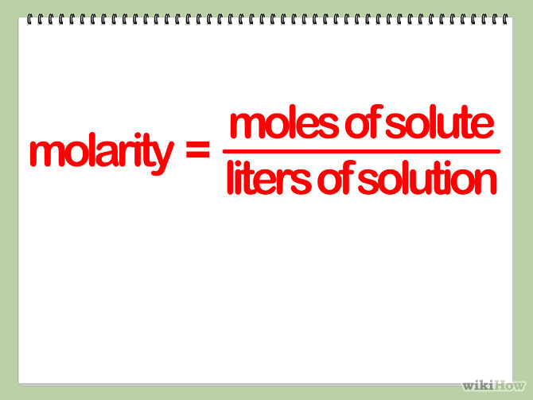
Solution concentration: Molarity
Molarity measures the number of moles in a liter of solution
STEP ONE: determine number of moles of solute
Take grams of solute and divide by the molar mass
STEP TWO: determine the total volume of solution
Make sure to convert the volume to liters
  If in milliliters, divide by 1000
  STEP THREE: complete calculation

Slide 4
Solution concentration: Molarity(M)
Sample problem:
4.5 g of HCl are in 400 mL of water
STEP ONE: determine number of moles of solute
Molar mass of HCL = 36.5 g/mol
4.5 g/36.5 g = .22 moles
STEP TWO: determine the total volume of solution
400 mL of H₂O /1000 = .400 L
STEP THREE: complete calculation:
.22 mol/.400L = .55 mol/L or .55 Molar

Slide 5
Solution concentration: Molarity(M)
Your turn:
5.0 g of H₂SO₄ are in 250 mL of water
STEP ONE: determine number of moles of solute
STEP TWO: determine the total volume of solution
STEP THREE: complete calculation:

Slide 6
Solution concentration: Molarity(M)
Check your work:
5.0 g of H₂SO₄ are in 250 mL of water
STEP ONE: determine number of moles of solute
Molar mass of H₂SO₄ = 98.1 g/mol
5.0 g/98.1 g = .051 moles
STEP TWO: determine the total volume of solution
250 mL of H₂O /1000 = .250 L
STEP THREE: complete calculation:
.051mol/.250L = .20 mol/L or .20 Molar

Slide 7
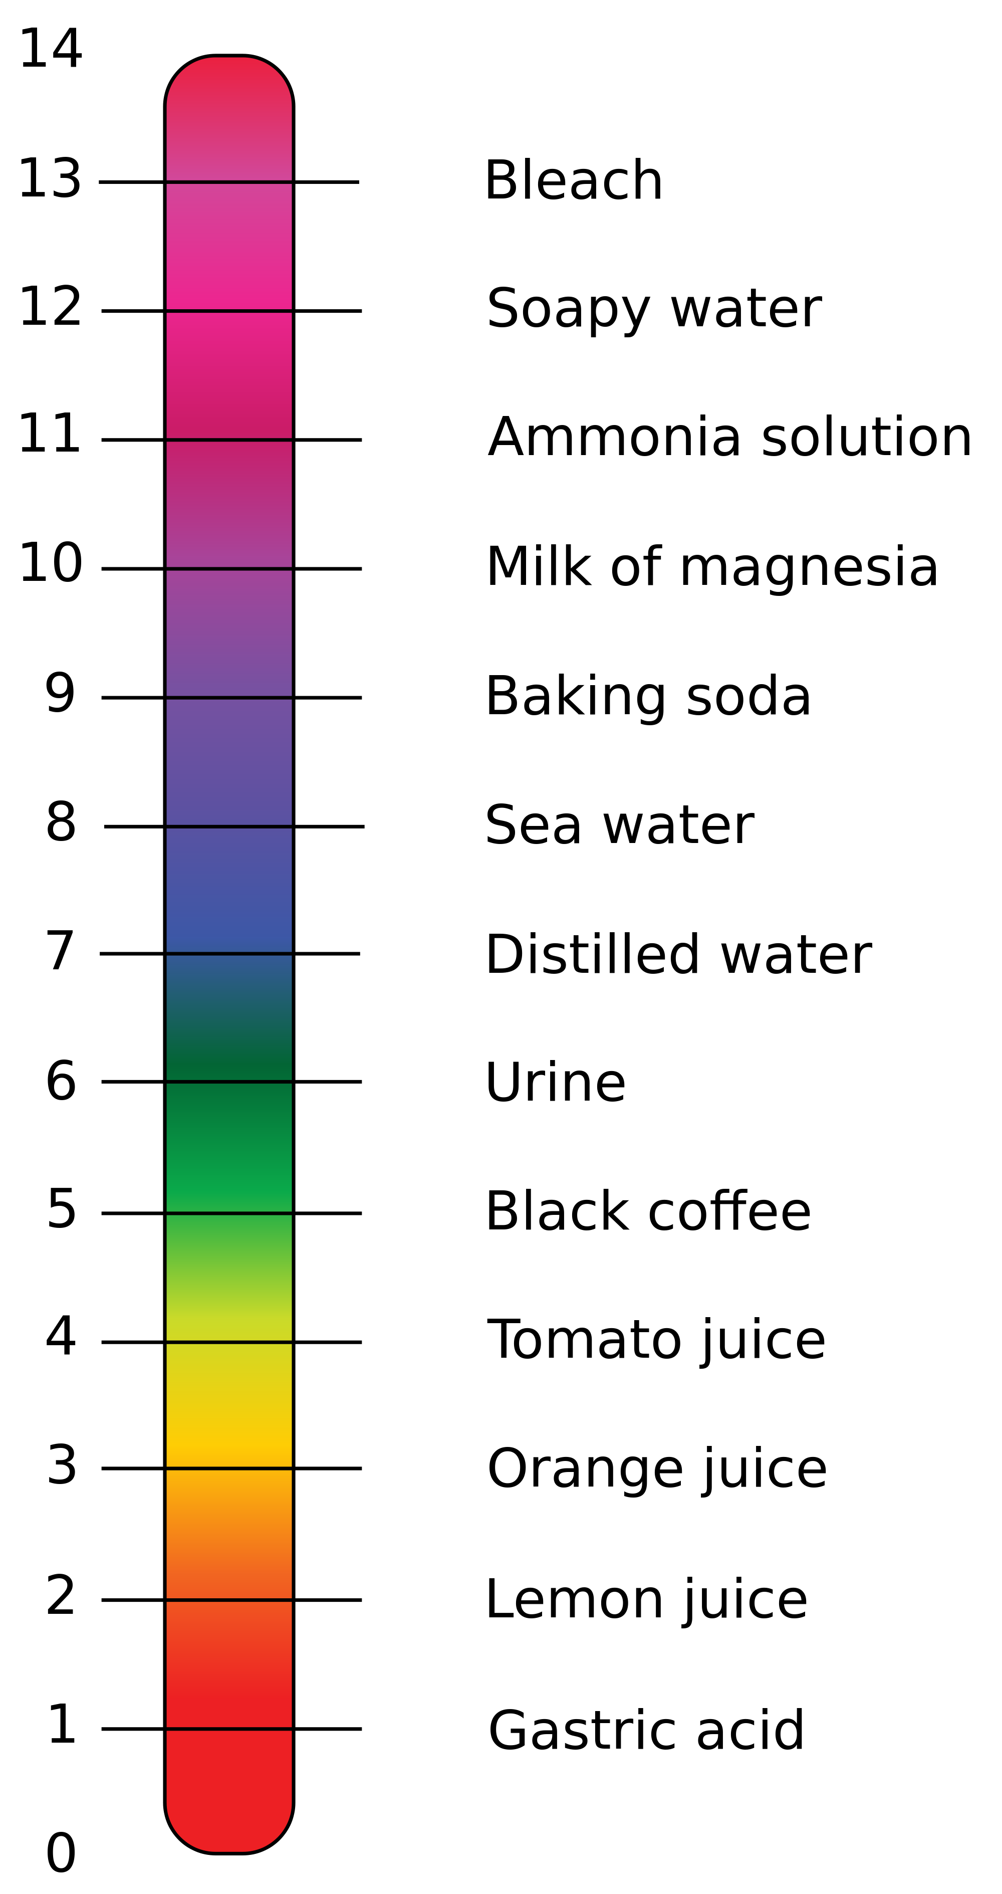
pH: power of the Hydronium ion [H₃O⁺]
Measures the hydrogen/hydronium ion concentration in water
  Strong acids dissociate very easily in water.
  Weak acids have very poor dissociation in water.
Scale of 1 – 14
1 – 6, acidic
7, neutral
8 – 14, basic
In milk that has “soured,” bacteria use the sugars in milk to form lactic acid
In soils, the type of bedrock, acidity of rain, and environmental factors determine the pH
https://commons.wikimedia.org/wiki/File:PH_Scale.svg

Slide 8
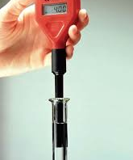
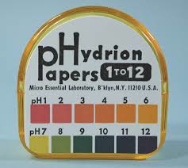
Quantitative methods to measure pH
pH probe/meter
pHydrion paper
Qualitative methods to measure pH
include:
Llitmus paper
Cabbage juice
Phenolphthalein
Methyl red
And many others…
  But these do not give an actual concentration/degree of acidity
https://www.microessentiallab.com/Category/132_1/pH.20_Paper.aspx

Slide 9
pH Calculations
pH: power of the hydrogen ion [H⁺]
Measures the hydrogen/hydronium ion concentration in water
STEP ONE: determine the concentration of hydrogen ions
= molarity of a strong acid
STEP TWO: complete calculation based on formula

Slide 10
pH Calculations sample calculation
What is the pH of a .55M HCl solution?
STEP ONE: determine the concentration of hydrogen ions
HCl is a strong acid, therefore [H+] = .55M
STEP TWO: complete calculation based on formula
pH = - log[.55] = .26
Does this pH support that it is a strong acid according to the scale?

Slide 11
pH Calculations your turn:
What is the pH of a .20 M H₂SO₄ solution?
STEP ONE: determine concentration of hydrogen ion
STEP TWO: complete calculation based on formula
Does this pH support that it is a strong acid according to the scale?

Slide 12
pH Calculations check your work…
What is the pH of a .20 M H₂SO₄ solution?
STEP ONE: determine concentration of hydrogen ion
H2SO4 is a strong acid, therefore [H+] = .20 M
STEP TWO: complete calculation based on formula
pH = - log[.20] = .70
Does this pH support that it is a strong acid according to the scale?

Slide 13
Ideas for Further Investigation:
1. Investigate pH of the soil prior to and after crop harvest.
2. Investigate pH of various crop fields before and after harvest.
3. Investigate changes in pH of soy vs cow milk over time (measure "sourness" and spoilage rates).

