Slide 1

The Colligative properties of molality and freezing point depression
A brief introduction to freezing point depression
grownextgen.org

Slide 2

What is molality?
A quantitative method to measure solution concentration.
http://www.swiftutors.com/admin/photos/molality-formula.png
Moles of solute: grams of solute/molar mass of solute
Kilograms of solvent for water (which is what we will use): milliliters of water = grams of water/1000
We can use this to calculate our salt water concentration.

Slide 3
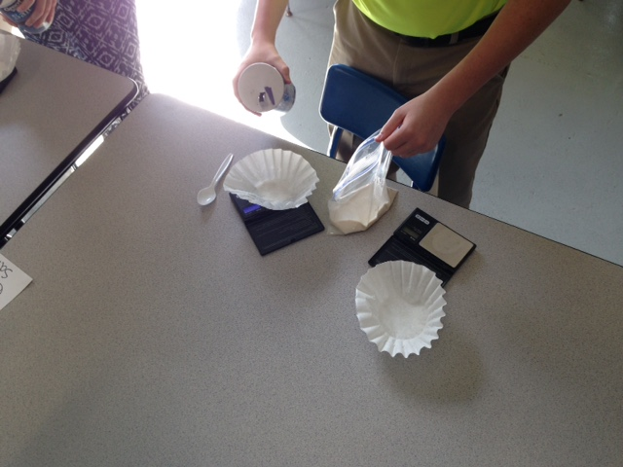
Let’s calculate the moles of NaCl used to make ice cream.
Using 60.00 g of NaCl
Molar Mass of NaCl = 58.5 g/mol
  1 sodium atom weights 23.0 g/mol and 1 chlorine atom weighs 35.5 g/mol as listed on the periodic table
  60.00 g NaCl/58.5 g/mol =
  1.03 moles of NaCl

Slide 4
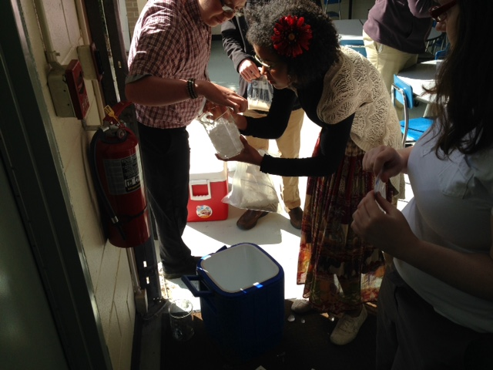
Let’s calculate the mass of the solvent
(ice/water)
Using 960.00 g of ice
960 g ice = .960 kg ice

Slide 5

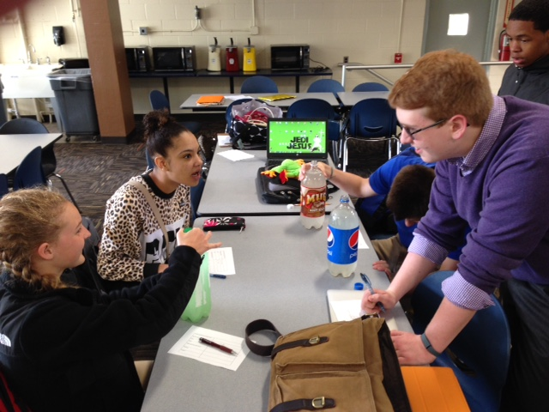
Now let’s calculate the molality…
Molality = 1.03 mol/.960 kg = 1.07 mol/kg or 1.07 m

Slide 6
What is freezing point depression?
Freezing point depression ( T_{f} ): change in the freezing point of a solution
It is how far the freezing point of a solution will lower (depress) due to the addition of solute particles
http://calculator.swiftutors.com/freezing-point-depression-calculator.html
Where: m = molality of the solution (calculated on previous slide)
K_{f} = freezing point constant for the solvent
for water = 1.86ºC/m
i = number of particles the solvent will dissociate
-for ionic compounds, it is equal to the number of ions
-for covalent compounds it is equal to ONE

Slide 7
For our salt solution?
http://calculator.swiftutors.com/freezing-point-depression-calculator.html
NaCl is ionic and will dissociate into 2 ions (Na⁺ and Cl ⁻)
so i = 2
K_{f} = freezing point constant for the solvent
for water = 1.86ºC/m
m = 1.07 m
T_{f} = 2 x 1.86ºC/m x 1.07 m = 3.98 ºC
Which means that by adding 60 g of salt to the 960 g of ice,
the temperature of the solution now should be depressed
3.98 ºC below normal freezing point (which is 0ºC)
…new solution may chill down to – 3.98ºC

Slide 8


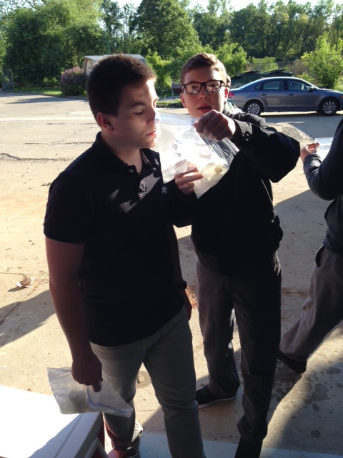
So what does that mean for us?
Ice cream…we can depress the freezing point down to freeze the milk/sugar solution in the bag and enjoy☺

Slide 9
A few final words…and looking further
Freezing point depression is also used to determine brine solutions, rock salt, quick melt (CaCl₂) on roads/walk in winter to “melt” the ice
  It really doesn’t melt the ice, but rather depresses the freezing point of the water (ice)
  Reason why these solutes don’t work in very cold temperatures
    Won’t depress the freezing point that far down
    Extensions:
    Could investigate effectiveness of various ionic compounds for melting ice
    Could investigate environmental impacts of various de-icers
    Could investigate other bioproducts to act as deicers

