Slide 1
Biodiesel
By: Ben Hobbs

Slide 2
Unit Objectives
What is biodiesel or diesel for that matter?
The chemistry of how biodiesel made?
How can it be used?
Biodiesel and the environment

Slide 3
What is diesel
Diesel fuel is primarily a transportation fuel.
  18-Wheelers/Rigs
  Dump trucks and construction equipment
  School Buses
  Automobiles
  High capacity lawn equipment
It can also be used to power generators
Same number of carbon atoms as home heating oil
Notes:
- This might be a good place to include some information about Rudolf Diesel and his original concept for the diesel engine. Vegetable oil was his initial fuel of choice for his engine.

Slide 4
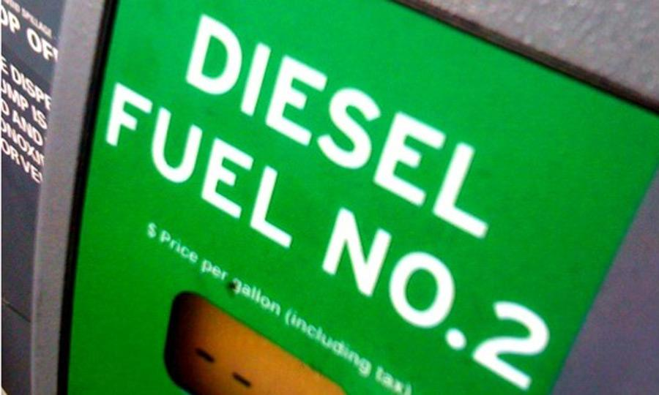
What is diesel?
#2 diesel is a derived from petroleum
Crude oil is fractionally distillated to extract all the various lengths of hydrocarbon chains according to their boiling points.
#2 diesel has a boiling range of 350-650 degrees Fahrenheit
For comparison gasoline’s range is 80-400 degrees Fahrenheit.
Notes:
If fractional distillation has not been discussed by this point in the year, I would recommend using the brief overview from How Stuff Works, it gets the job done.
http://science.howstuffworks.com/environmental/energy/oil-refining2.htm

Slide 5
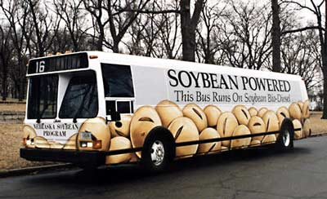
What is biodiesel
Technically, biodiesel is a mono alkyl ester made from renewable oils or fats.
Any vegetable oil can be converted to biodiesel.
Favorites include:
  Soybean oil
  Corn oil
  Canola oil

Slide 6
What is biodiesel
It is biodegradable and non-toxic
It is completely miscible in petroleum-based diesel, thus allowing for blends of the two
Burns identically to its petroleum-based equivalent
The byproducts of its production are minimal and usable for other purposes.
Notes:
Here is a link to Daryl Hannah taking a taste of biodiesel (http://eco-living.blogspot.com/2006/10/bio-diesel-with-daryl-hannah.html)

Slide 7
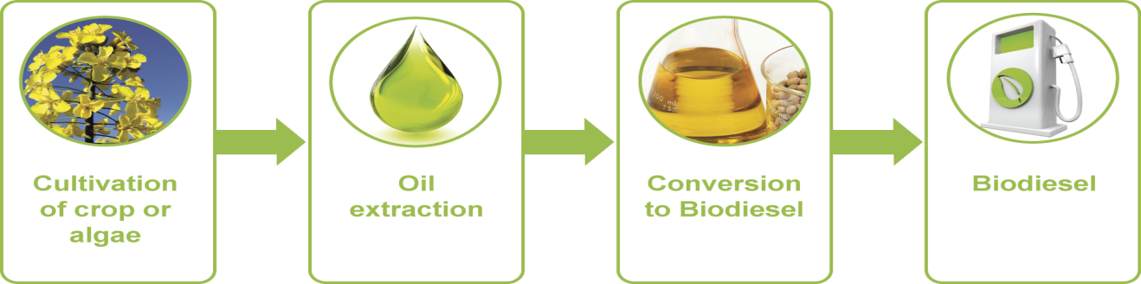
How is biodiesel made?

Slide 8
It begins with the cultivation of a crop.
Through May 2013, over 2.3 billion pounds of agricultural crops have been used to produce biodiesel in the US.
1.8 billion pounds are from soybeans alone.
Through May 2013, manufacturers in the US have produced 449 million gallons of biodiesel.
Ohio is the 6th largest soybean producing state in the US.
Source: http://www.eia.gov/biofuels/biodiesel/production/table3.pdf

Slide 9
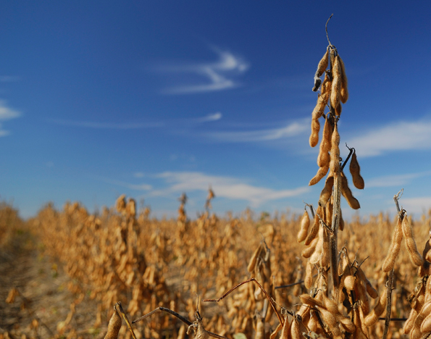

Slide 10
Oil Extraction
Extracting the oil from the feedstock is not a simple process.
It involves a few steps we can decipher
  Cleaning, drying, and removing debris
  Addition of a solvent
  Flaking
  Decanting
  Storage
Notes:
Video: http://www.youtube.com/watch?v=YKP_y7Nc4aw

Slide 11
Converting to Biodiesel
Once you have the straight vegetable oil converting to biodiesel is pretty easy.
Transesterification
  Treat the oil with a combination of a strong base and an alcohol.
  Typically this is NaOH or KOH combined with methanol or ethanol.
  What happens during the reaction?

Slide 12
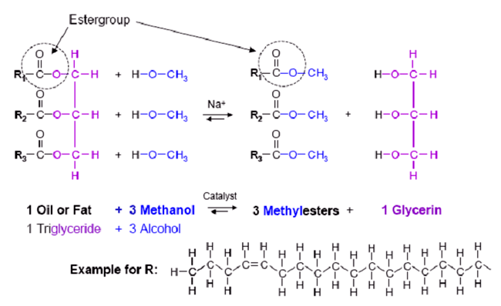
Transesterification

Slide 13
What was that?
It’s not as hard as it looks.
All fats have basically the same structure
  A glycerol backbone
  3 fatty acid chains branching off the glycerol
Transesterification basically strips the glycerol away, and adds a methanol where the glycerol had been.

Slide 14
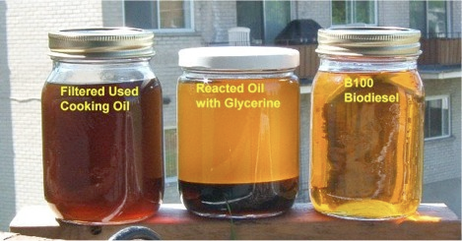
What’s next?
After the reaction occurs what’s left?
  Biodiesel on top
  Glycerin on the bottom
Notes:
There are more steps to do after the initial reaction. That’s covered in the text of the lab.

Slide 15
How is it used?
Since it is miscible in petroleum-diesel biodiesel can be blended to any ratio.
Naming Convention:
  B = biodiesel
  Number following = % biodiesel
    B2 = 2% biodiesel, 98% petroleum diesel
    B20 = 20% biodiesel, 80% petroleum diesel
    B100 = 100% biodiesel
Available at over 850 retailers nationwide

Slide 16
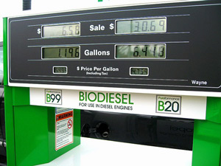
Biodiesel Pump

Slide 17
Biodiesel and the Environment
Biodiesel, even at low % concentrations, reduces carbon monoxide, particulates, and unburned hydrocarbons.
CO₂ emissions, for both production and use, can be reduced by almost 80%, when compared to petroleum-diesel.
For every unit of fossil energy it takes to produce biodiesel, 5.5 units of energy are returned.

Slide 18
Biodiesel and the Environment
Ozone potential is reduced by up to 50%
Sulfur emissions are eliminated completely with B100
NO_{x} emissions increase up to 10% with B100
Other carcinogenic pollutants, such as polycyclic aromatic hydrocarbons are reduced compared to petroleum-diesel.

