Slide 1

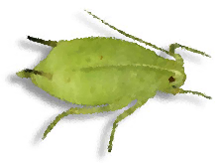
Soybean Aphids

Slide 2
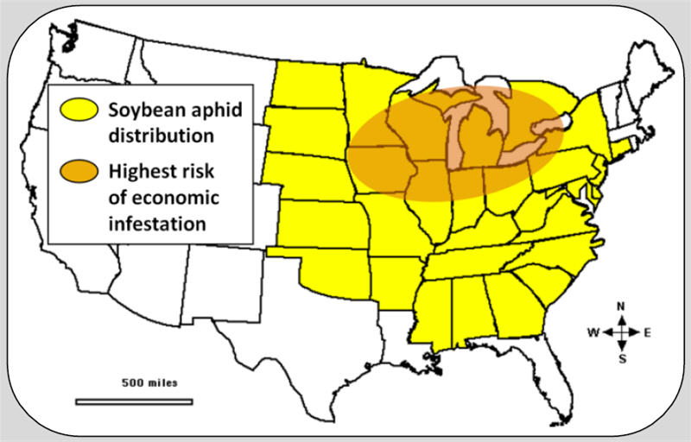
Since the invasion of the Soybean aphid from Asia in the 2000 growing season, aphids have spread across much of the United States.

Slide 3
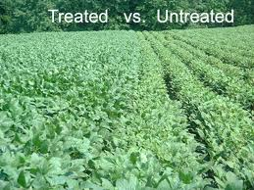
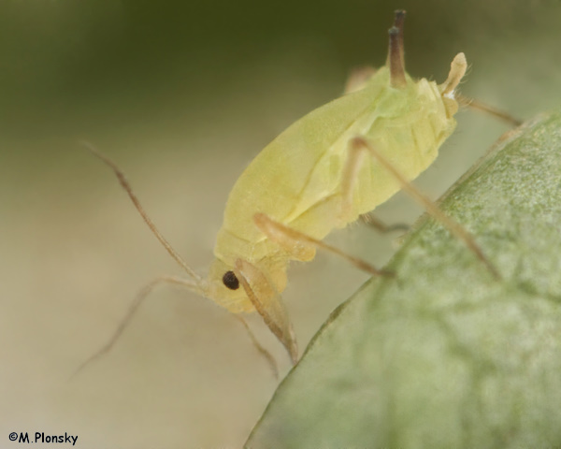
Soybean aphids are pests that pierce soybean tissues and feed on sap causing up to a 50% decrease in yield.
Growth differences between untreated (right) and insecticide-treated soybean (C. Louis)

Slide 4
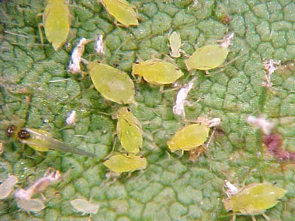
Aphids colonize soybeans in early June. These spring immigrants deposit live young under upper soybean leaves. Within a week, these nymphs mature into fully reproductive females that can deposit 2-3 young per day.
Colony of aphids in transition: Note winged female (left side), nymph developing wings (lower right), and numerous cast skins (white) (H. Russell).

Slide 5
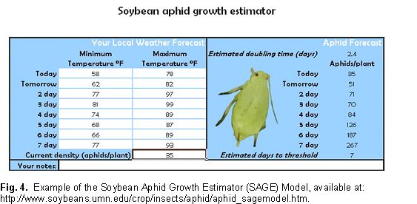
Populations build rapidly, doubling every 2 to 3 days, and may reach several thousand aphids per plant at their peak in early August.

Slide 6
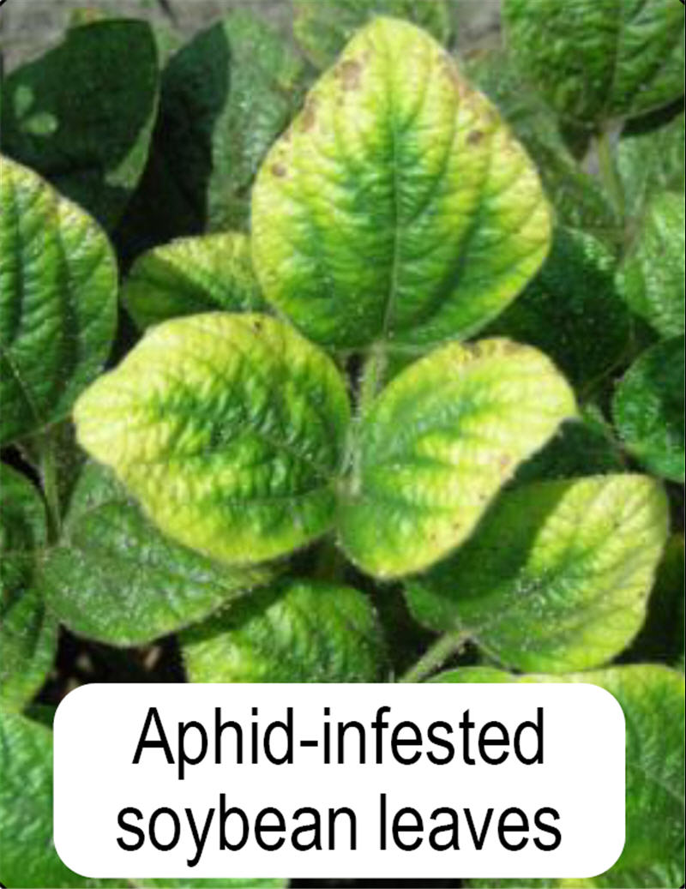
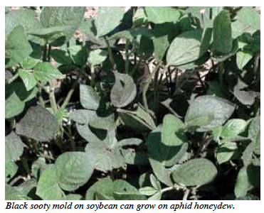
Feeding impacts yield in three ways: removal of photosynthates (sap), reduction in photosynthesis, and transmission of viral diseases.

Slide 7
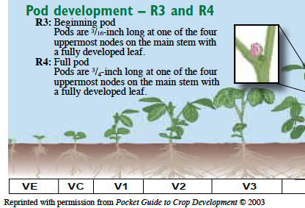
The risk of yield loss is greatest when aphid populations peak during the R1-to-R4 growth stages. During these stages, blooms and young pods are most susceptible to stress.

Slide 8
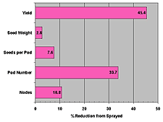
Continued feeding during reproductive stages reduces pod and seed set, and potentially seed size, if pressure continues.
Soybean aphid effects on yield and yield components in five severely infested fields (K. Ostlie)

Slide 9
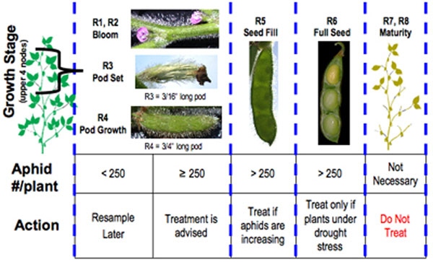
A farmer must choose how and when to apply an insecticide if the soybean aphid exceeds the economic threshold.

Slide 10
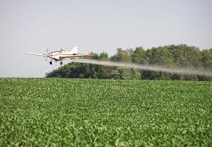
Pesticides can impact the environment and are a reactant, not a preventative.

Slide 11
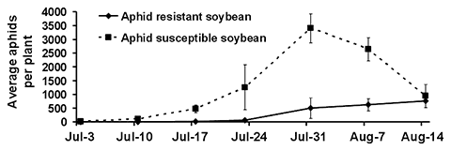
What if we could help nature help us out? Decrease aphid populations and increase yields with Aphid Resistant Soybeans.

Slide 12
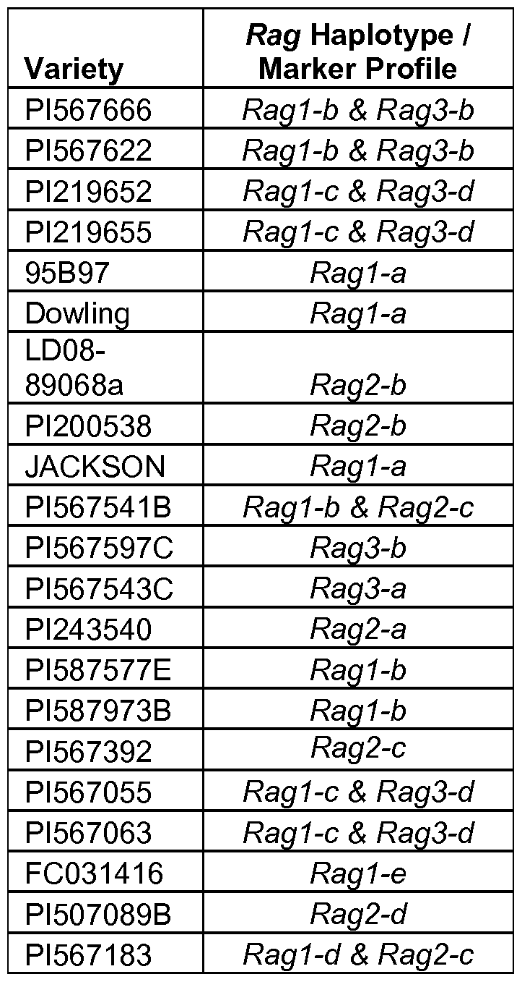
Host Plant resistance (Rag genes) is being intensively researched.
Antibiosis - suppresses aphid growth and reproduction
Antixenosis - the inability of an insect to find and/or feed on a plant
Tolerance - ability of a plant to produce yields despite insect feeding

Slide 13
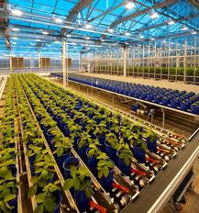
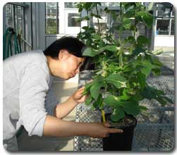
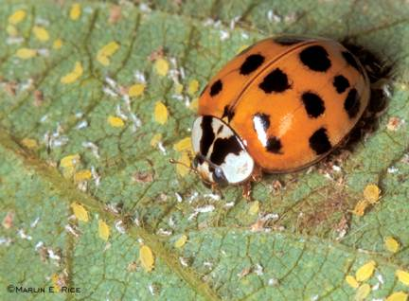
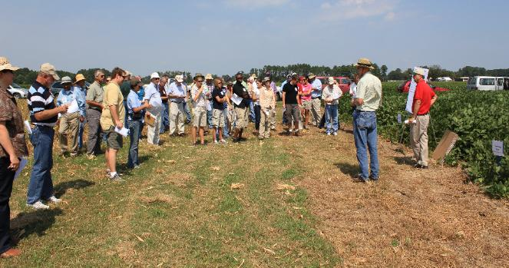
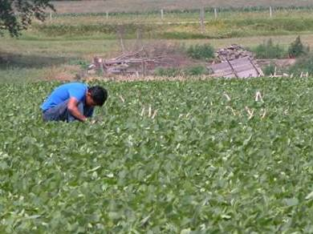
Seed research, farmer awareness, scouting, and pest management will help control the soybean aphid and increase yields.

Slide 14
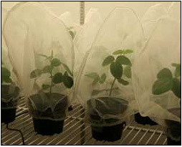
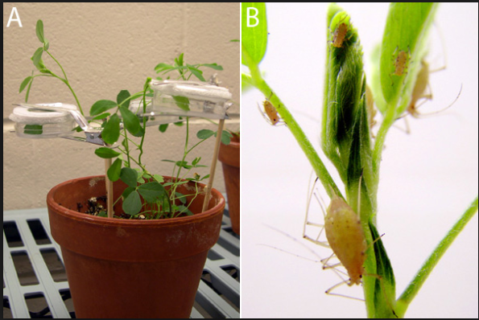
Aphid Resistance Experiment

Slide 15
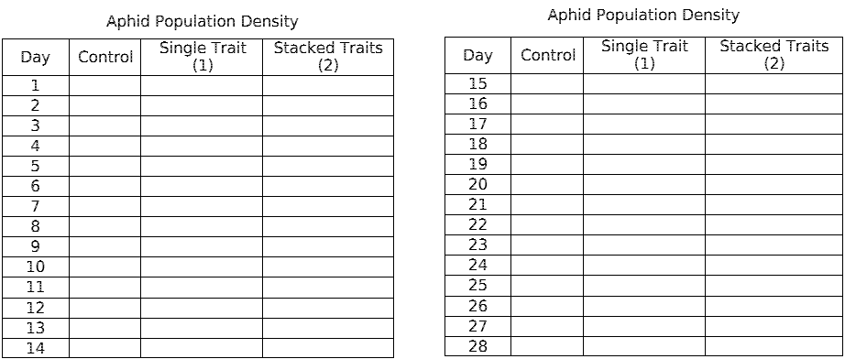
Aphid Resistance Experiment

Slide 16
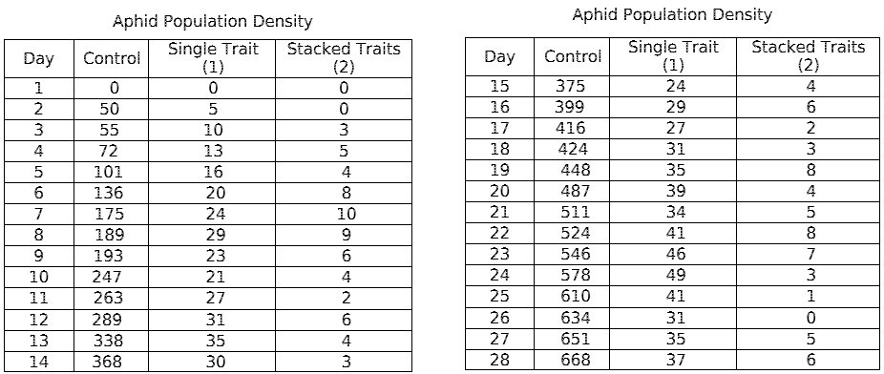
How does your data compare?

Slide 17
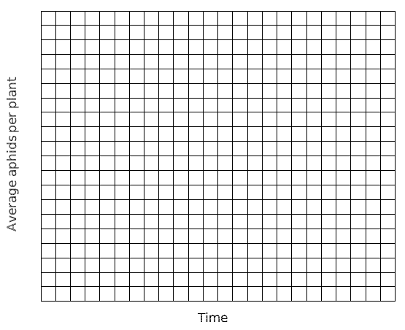
Plot your data

