Slide 1

Molecules and Covalent Bonding
Substances that are formed by covalent bonding are called molecules.
They are characterized by:
Bonding formed by two non-metals sharing electrons.
Being mostly liquids and gases
Having lower melting point and boiling point
Not conductors of electricity

Slide 2
Covalent Bonding
Covalent bonding occurs in molecular substances. In covalent bonding
electrons are shared so that atoms can have a complete valence shell of electrons
involve a bond between two nonmetals.
usually occur between elements are close to each other on the Periodic chart.

Slide 3
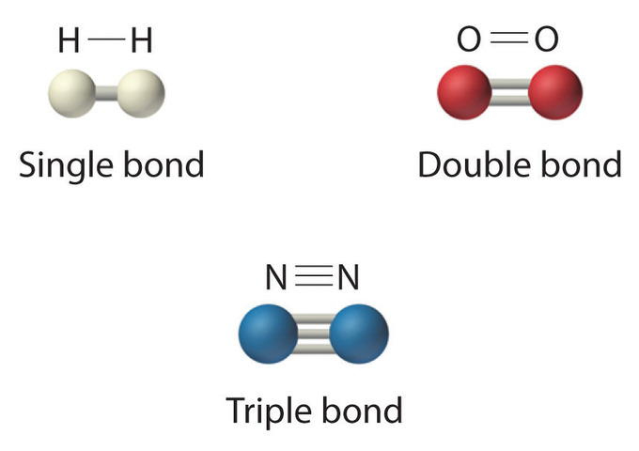
Single covalent bonds – share 1 pair of e’s
-one sigma bond
Ex: H₂
Double Covalent bonds – share 2 pairs of e’s
-one sigma and one pi bond
Ex: O₂
Triple Covalent Bonds – share 3 pairs of e’s
-one sigma and 2 pi bonds
Ex: N₂
https://www.boundless.com/chemistry/textbooks/boundless-chemistry-textbook/basic-concepts-of-chemical-bonding-9/the-covalent-bond-73/double-and-triple-covalent-bonds-341-8343/

Slide 4
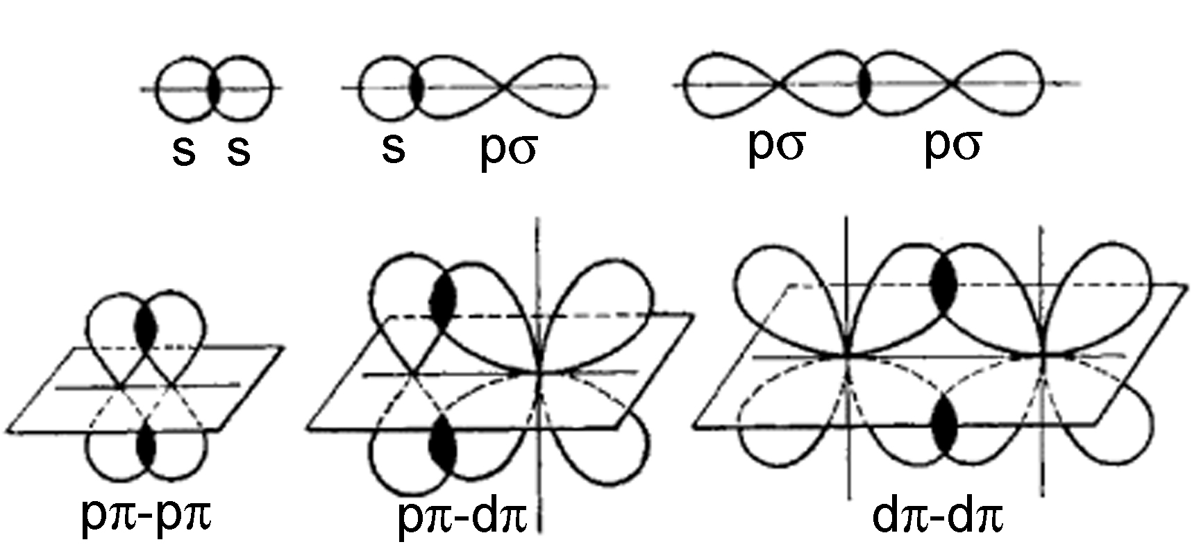
Sigma bonds σ
• strongest covalent bonds.
• connect two orbitals by end-to-end overlap; electrons are found within the space where the orbitals overlap.
• electrons freely rotate around the bond axis. (cis)
Pi bonds π
• side-to-side overlap of two parallel p orbitals
• weaker than sigma bonds; due to smaller overlap between the orbitals, but in combination with sigma bonds (double or triple bonds) they create a much stronger bond between molecules.
• prevent free rotation of molecules around the bond (trans)
https://commons.wikimedia.org/wiki/File%3ASigma_and_pi_bonding.jpg
Notes:
Attribution of graphic:
By Tem5psu (Own work) [CC BY-SA 3.0 (http://creativecommons.org/licenses/by-sa/3.0)], via Wikimedia Commons

Slide 5
# of bonds Bond Length Dissociation Energy
F₂ single 1.43 x 10⁻¹⁰ m 159 KJ / mole
O₂ double 1.21 x 10⁻¹⁰ m 498 KJ / mole
N₂ triple 1.10 x 10⁻¹⁰ m 945 KJ / mole
Trend: ? As the # of bonds increase…

Slide 6
Naming Covalent Compounds
1 – mono
2 – di
3 – tri
4 – tetra
5 – penta
6 – hexa
7 – hepta
8 – octa
9 – nona
10 – deca

Slide 7
Naming Acids
Oxyacids:
Name these:
H2C2O4
H3PO4
Write the formula for these:
Nitric acid
Sulfuric acid

Slide 8
Naming Acids
Binary Acids:
Name these:
HCl
H2S
Write the formula for these:
Hydrofluoric acid
Hydroiodic acid

Slide 9
Molecular Structures
Molecular Formula Dot Diagram Structural Formula
H2 H : H H-H

Slide 10
Structural Formulas
Find the central atom
2. Find the total number of valence electrons*
*(if there is a charge, then add or subtract electrons)
3. Divide the total number of valence e’s by 2.
This = the number of electron pairs.
4. Place 1 pair between the central atom and
the terminal atoms.
5. Place the remaining pairs about the atoms to
satisfy the octet rule.
Ex: NF3, ClO4⁻

Slide 11
Exceptions to the octet rule:
When there is an odd number of valence electrons.
Ex: NO₂

Slide 12
Exceptions to the octet rule:
2. Some compounds form with fewer than eight valence electrons.
Ex: BH3
- There are small central atoms that cannot fit a full four pairs of electron around them. B, Al, Be

Slide 13
Exceptions to the octet rule:
3. Expanded Octet Rule – The central atom has more than four pairs of electrons around them.
Ex: PCl5

Slide 14
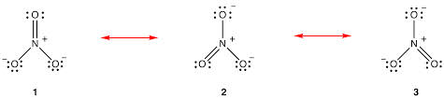
Exceptions to the octet rule:
4. Resonance Structures – A condition that occurs when more than one structure can be drawn for the molecule.
Ex: [NO3]⁻¹
The actual nitrate ion is an average of all three structures.

Slide 15
Predicting Molecular Shapes:
VSEPR Model
Many chemical reactions depend on the ability of one molecule to make contact with another.
The shape of the molecule affects this.

Slide 16
Valence Shell Electron Pair Repulsion Model (VSEPR MODEL)
This model predicts the shape of the molecule based on minimizing the repulsion of the valence electron pairs.
Bond angle – is the angle between two terminal atoms.
H
109.5º
C
H
H
H
..
N
H
107º H
H
. .
:O
H
H 104.5º
Methane
Ammonia
Water

Slide 17
How to predict the molecular shape
1. Draw the structural formula for the molecule.
2. Count the total number of electron pairs around the central atom that are shared with the terminal atoms and the number of pairs that are not shared (lone pairs.)

Slide 18
VSEPR Theory Predicts:
Shared Lone Shape
2 0 linear
3 0 trigonal planar
3 1 trigonal pyramidal
2 2 bent
4 0 tetrahedral
*****************************************
6 0 bipyramidal
8 0 octohedral

