Slide 1

Precision Agriculture

Slide 2
Definition
“…a management system that is information and technology based, is site specific and uses one or more of the following sources of data: soils, crops, nutrients, pests, moisture, or yield, for optimum profitability, sustainability, and protection of the environment.” (USDA, Agronomy Technical Note No.1, June 2007)

Slide 3
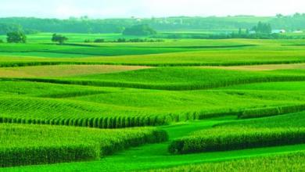
Purpose
maintain productivity and profitability of the agriculture system while attempting to maximize yield.
Photo: Mike Krivit

Slide 4
Techniques
soil testing to determine the amount of nutrients available and the amount needed to grow a specific crop;
hybrid or variety selection specific to the conditions under which it will be grown (climate, soil type, etc);
pesticide choices to address specific pests within a field;
using data from all of these techniques to make future decisions.

Slide 5
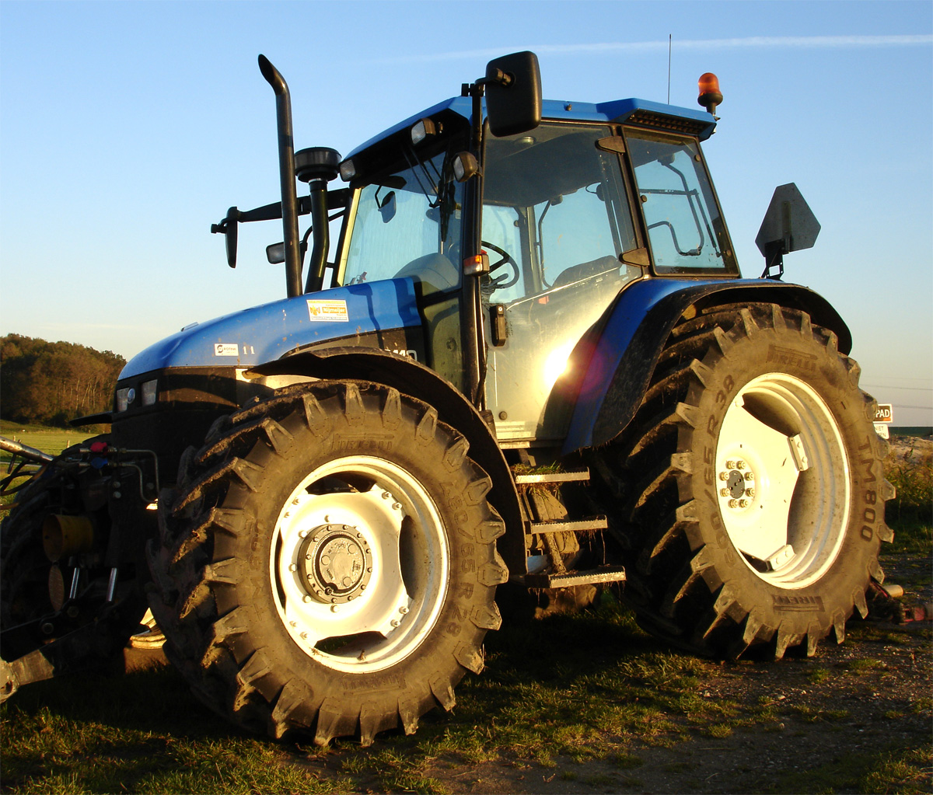
Technologies
Auto-steering of equipment
  maximize field use and decrease overlap of crop planting and fertilizer and pesticide application
GPS systems of various types
  enable auto-steering and other technologies
Variable rate seeding, fertilizer and pesticide application
Yield monitoring systems mounted to harvesters
Remote sensing to collect data about field health and responses to management strategies
Photo by Solitude [CC BY-SA 2.0 (http://creativecommons.org/licenses/by-sa/2.0)], via Wikimedia Commons

Slide 6
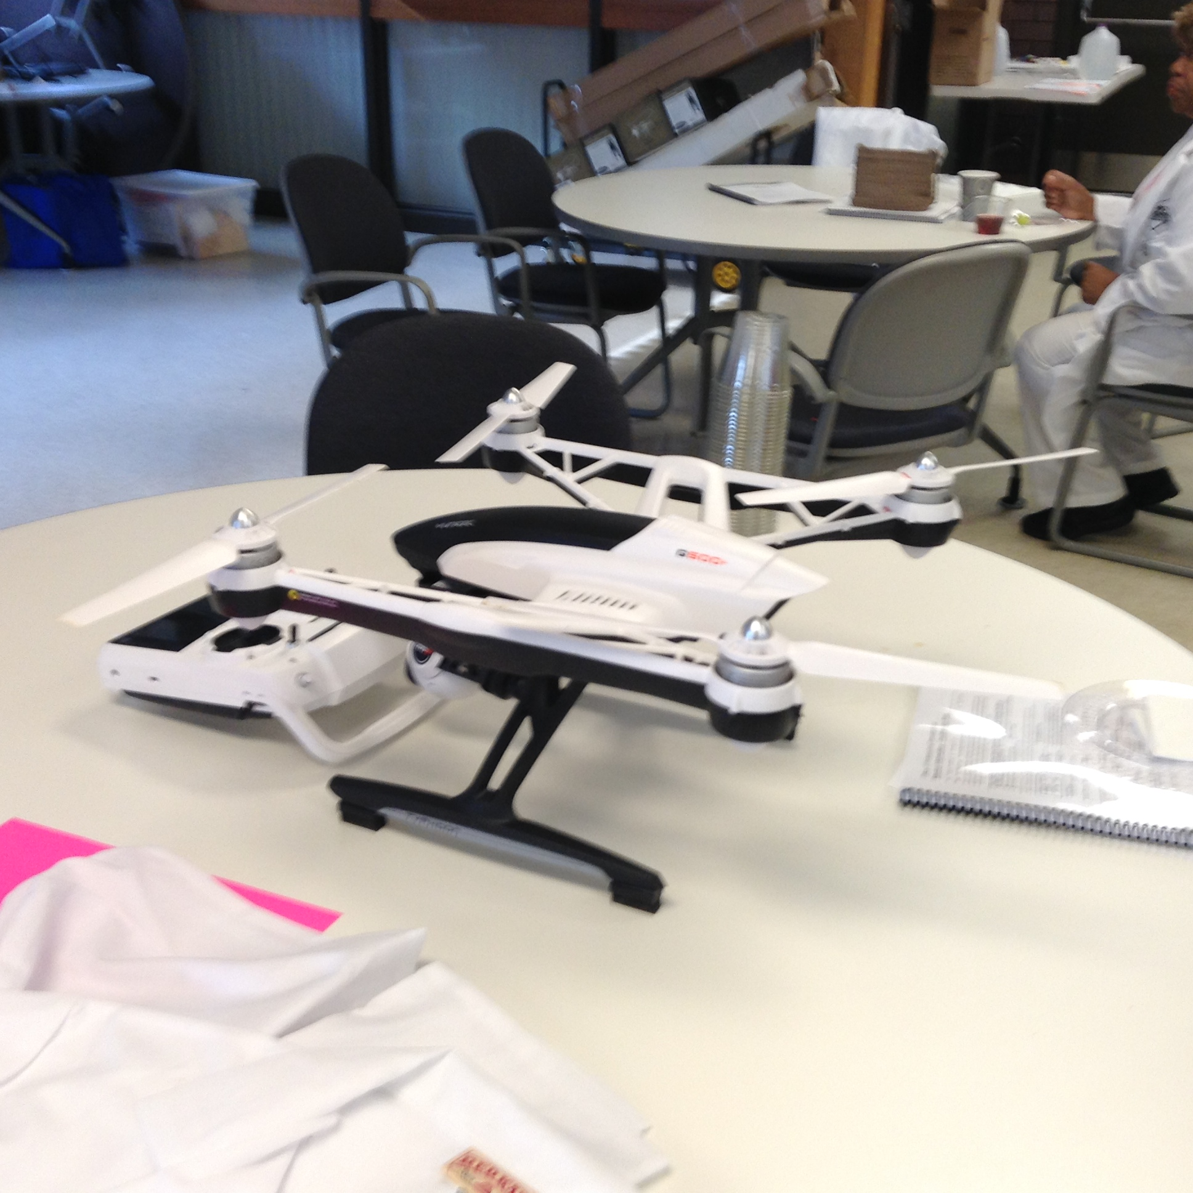
Benefits
Precise nutrient applications
Precise pesticide application
Variable rate irrigation
Ability to see what is happening in the field
Limiting trips over the field
  Lowers compaction
  Reduces fuel consumption

Slide 7
Watch these videos to get further information
What Happens When Farming Goes High-Tech? | National Geographic
    https://www.youtube.com/watch?v=tbkTi3zNN9s
Precision Farming and the Role of Big Data
    https://www.youtube.com/watch?v=amafl9pVBhI
Precision Farming “Digital Experience”
    https://www.youtube.com/watch?v=Eg6VUYhTkbc

