Slide 1
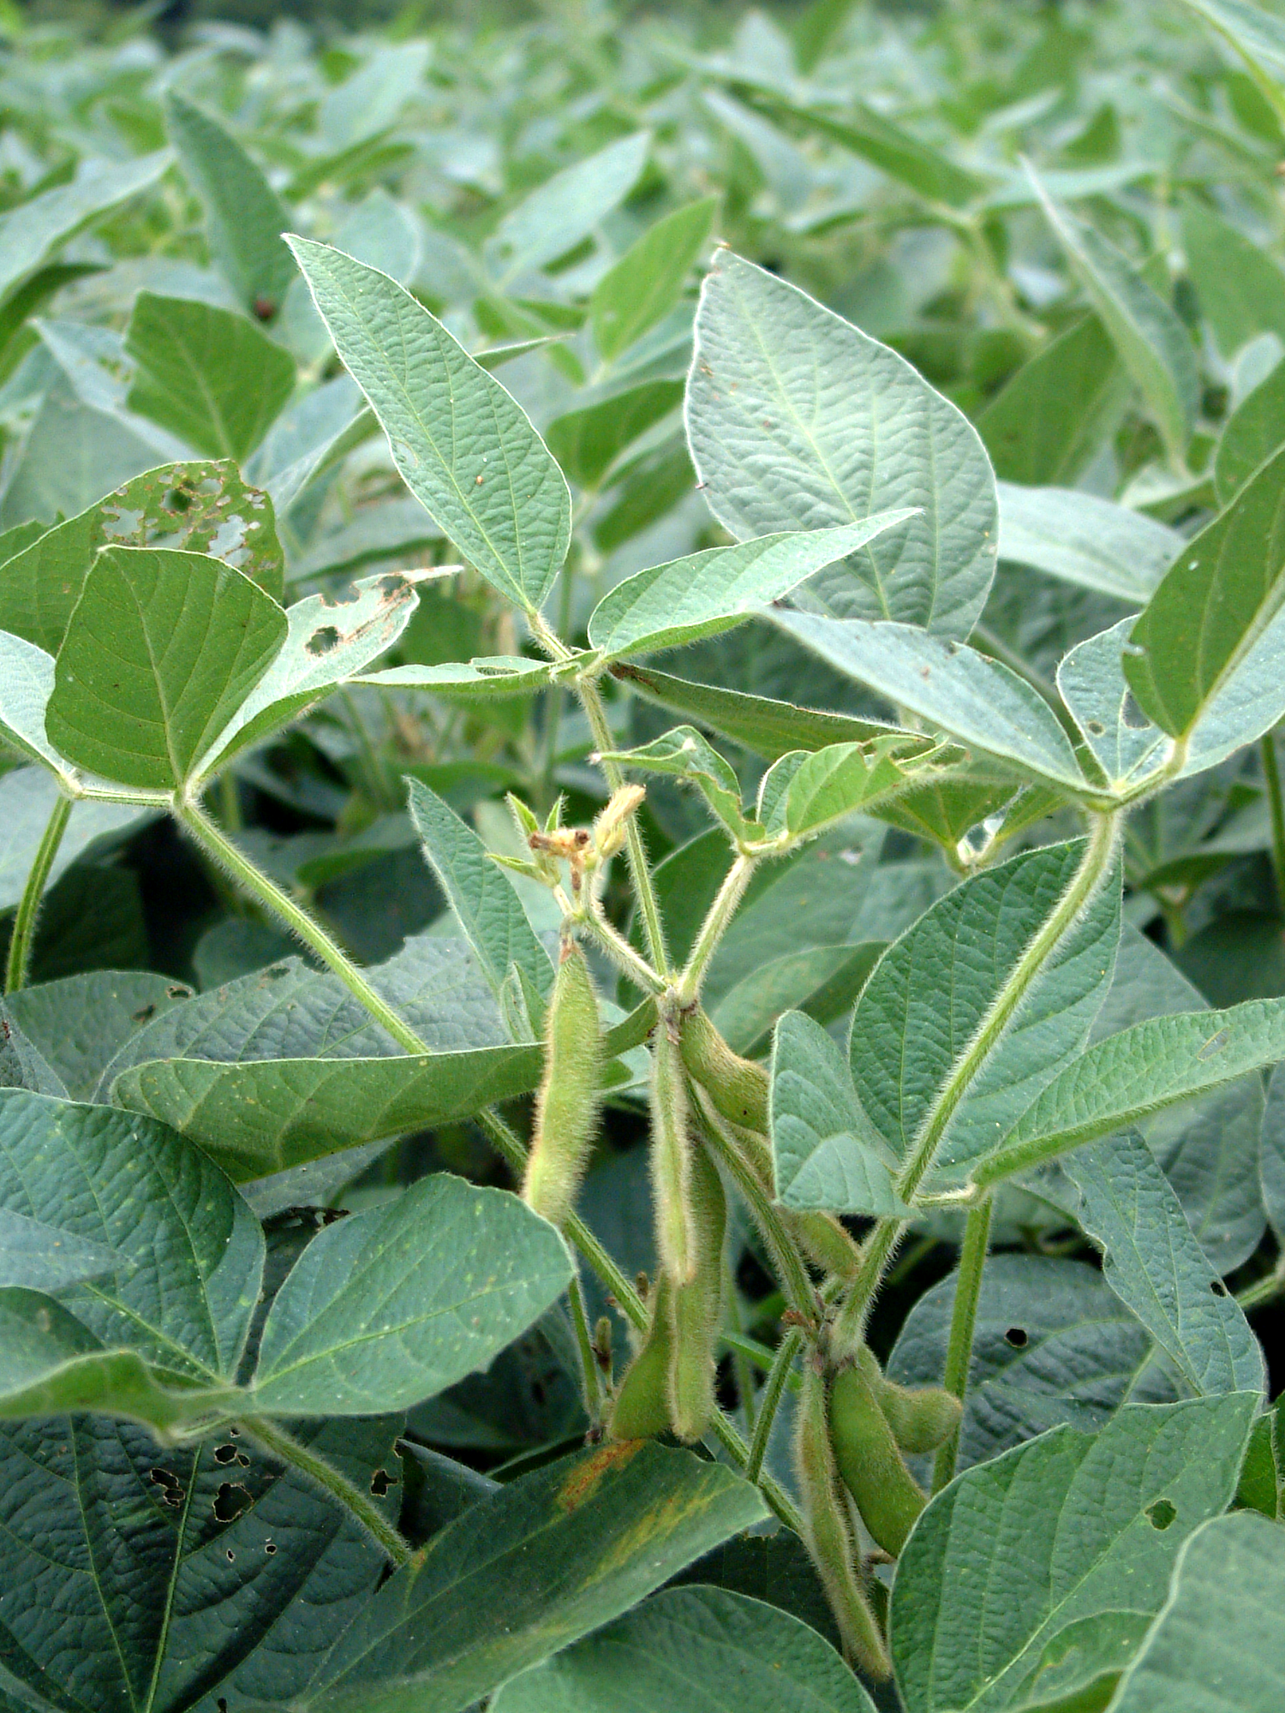
Case Study:
Sunrise Plots

Slide 2
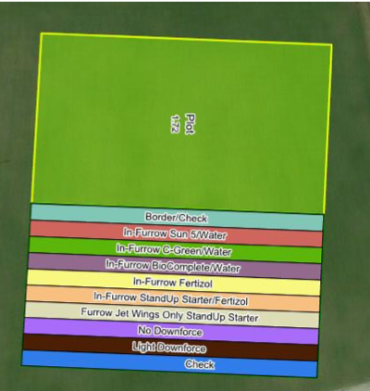
Soybean plot layout
Sunrise Cooperative South Charleston, OH
A
V
U
T
K
S
R
Notes:
This is a picture of the soybean plot. Each row represents a different type of treatment used.

Slide 3
What environmental factors affected growth this year?
April and May, 2019 experienced record rainfall. What is average?
Many days of rain reported.
The soybeans were planted around May 21.
This is a late planting date as a result of the amount of rainfall that Ohio experienced this year. What is a risk to the plants of too much rain after planting?
How would you describe what happened in the second half of the growing season? (July, August, and September)
Notes:
Have students investigate? Lindsay has a lesson!

Slide 4
Timeline
Compared to a normal timeline, make predictions about what the effect of this timing might be.
On June 11, the test plots were not ready for soil or tissue sampling due to the late planting date.
On July 22, the first tissue and soil samples were taken.
On July 26, dry fertilizer was applied to the entire corn plot.
On August 1, the second set of tissue and soil sampling was complete. The soil was extremely dry and broke a soil probe!
Notes:
Could find growing degree days for corn - investigate the days to maturity to determine which V or R stage

Slide 5
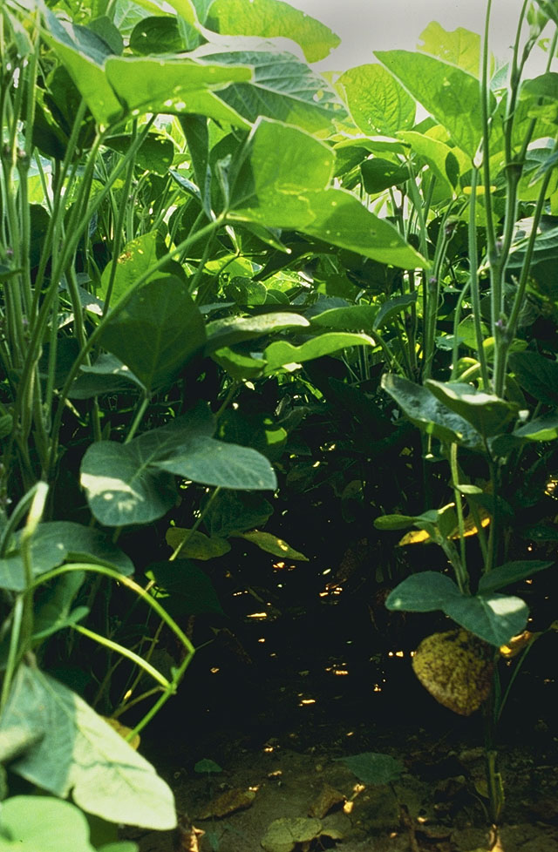
Variables
In the test plots, the following were controlled variables:
Type of seed
Herbicides applied
Type of soil
The variables that changed were:
The type and amount of fungicide used during treatments two times during the growing season.
Notes:
Fungicide is defined as a chemical the destroys fungus.

Slide 6
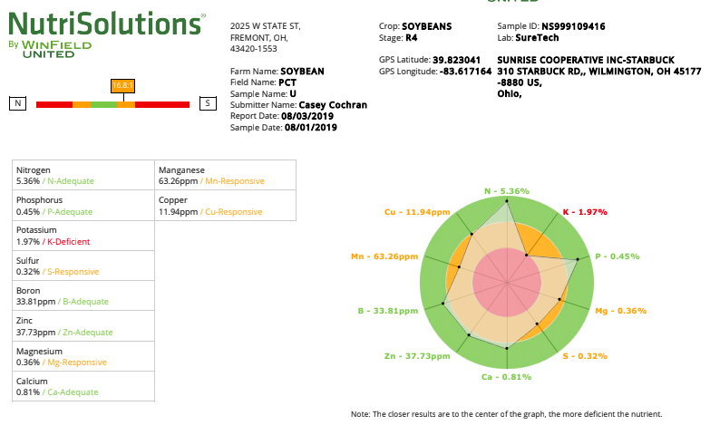
Notes:
This is a sample report of the data that was received.

Slide 7
You and your team are in charge of analyzing and reporting out on the case study from the Sunrise Cooperative test plot in South Charleston. Think about the different components that you are analyzing and how it could apply to a farmer deciding whether to invest in these products.
Here are the materials that will be provided:
Data spreadsheet with raw data
Plot map with variables
Information sheets that describe action of variables
Example of nutrient data that can be compared

Slide 8
Your conclusions
Use the data in the spreadsheet and the plot key to determine if one or more of the products had a positive effect on the soybeans.
Identify what positive effect you have found.
Determine what data analysis provides evidence for that effect.
Explain how the treatment may have influenced that effect.
If there is no positive effect, explain the potential reasons why that is the case.

